Slide 1
Google Cloud Platform
Lecturer: Ngo Huy Bien
Software Engineering Department
Faculty of Information Technology
VNUHCM - University of Science
Ho Chi Minh City, Vietnam
nhbien@fit.hcmus.edu.vn

Slide 2

Objectives
To create a Google Cloud Platform VM.

Slide 3

Contents

Slide 4

References

Slide 5
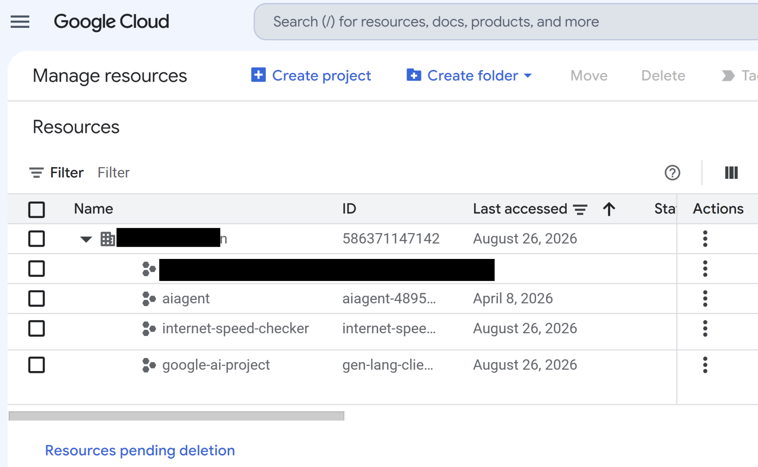
1. Manage Projects
https://console.cloud.google.com/cloud-resource-manager

Slide 6


Slide 7
1. Create a Virtual Machine
https://console.cloud.google.com/freetrial/signup

Slide 9
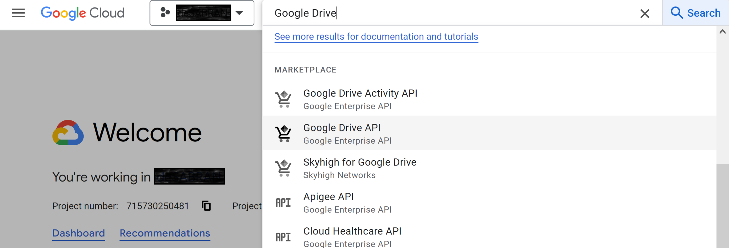
1. Search for Google Drive Product
https://github.com/glotlabs/gdrive/blob/main/docs/create_google_api_credentials.md

Slide 10
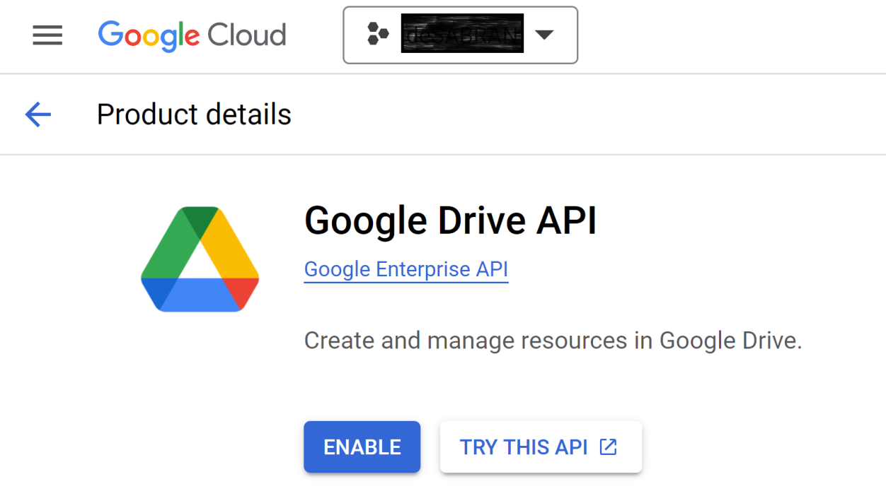
2. Enable Google Drive API

Slide 11
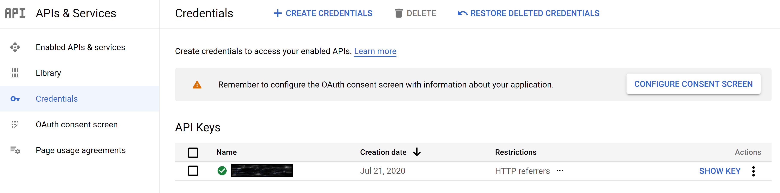
3. Configure Consent Screen

Slide 12
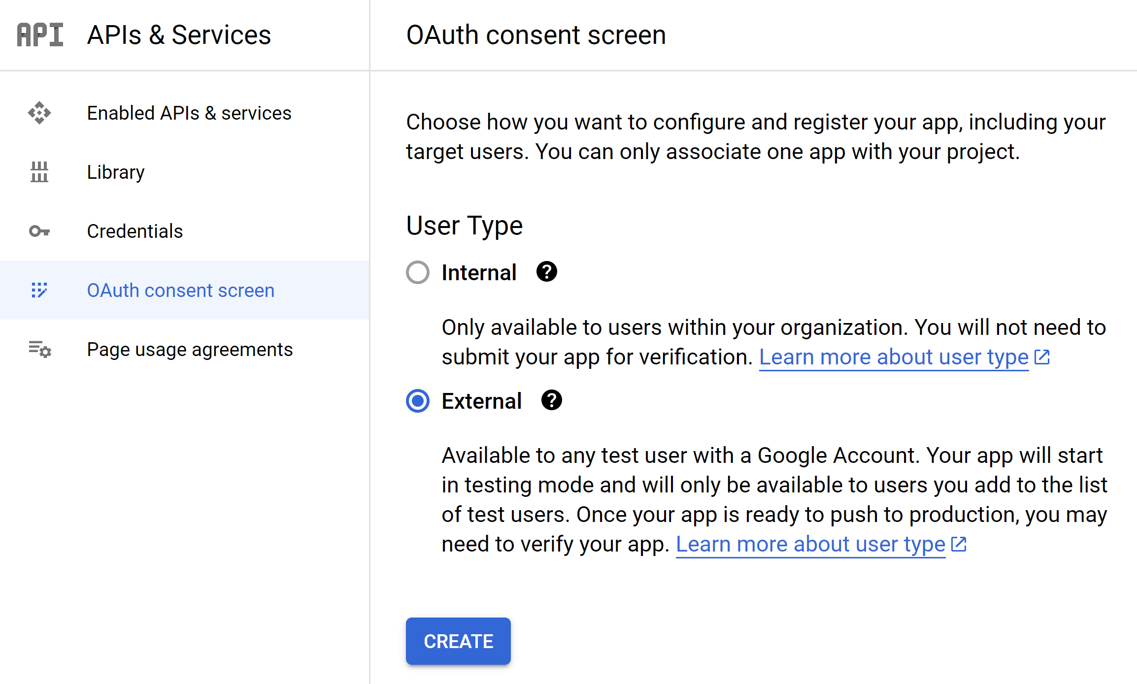
4. Select External User Type

Slide 13
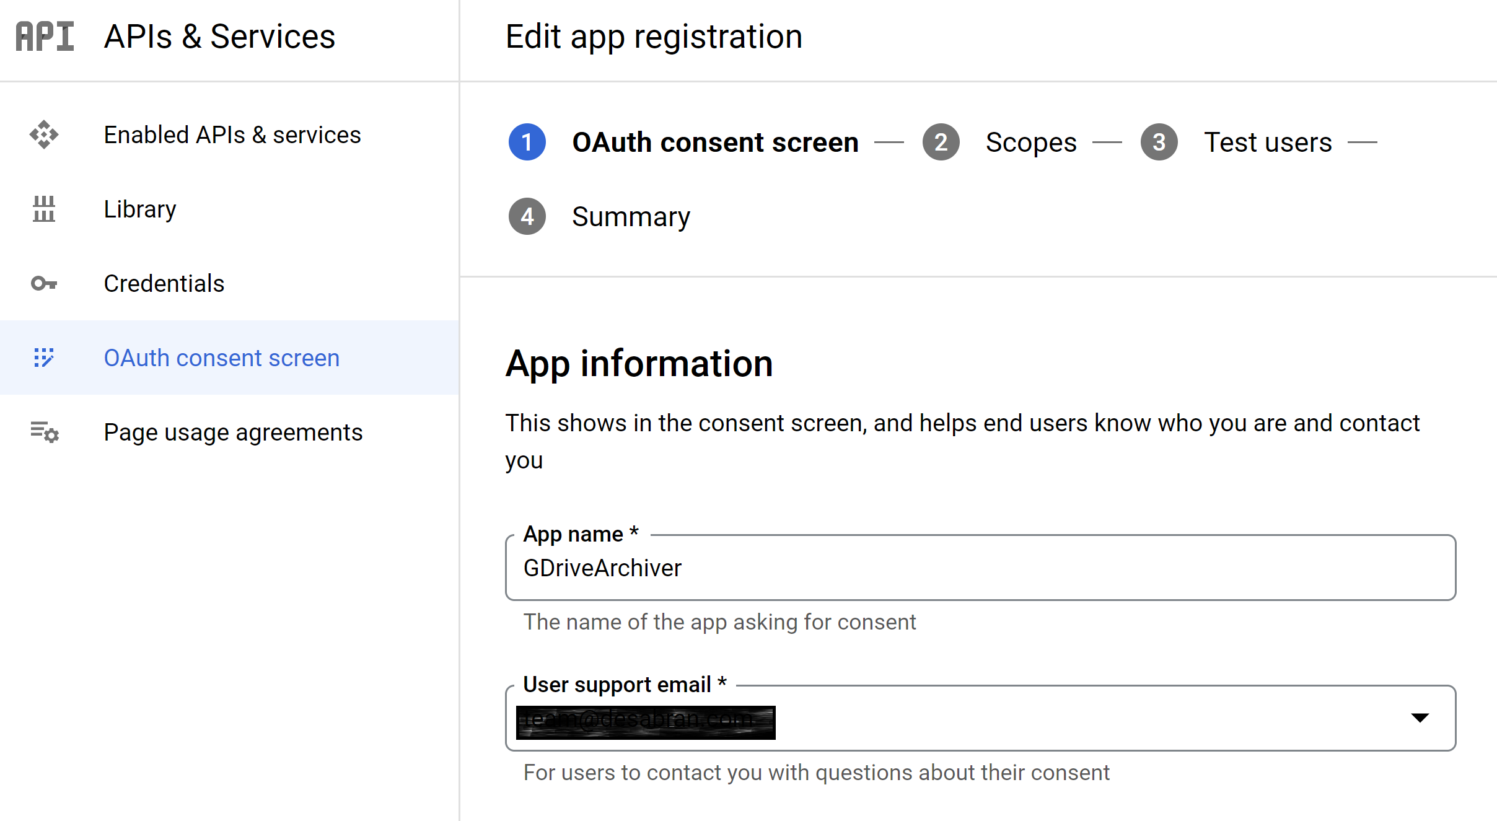
5. Enter App Information

Slide 14
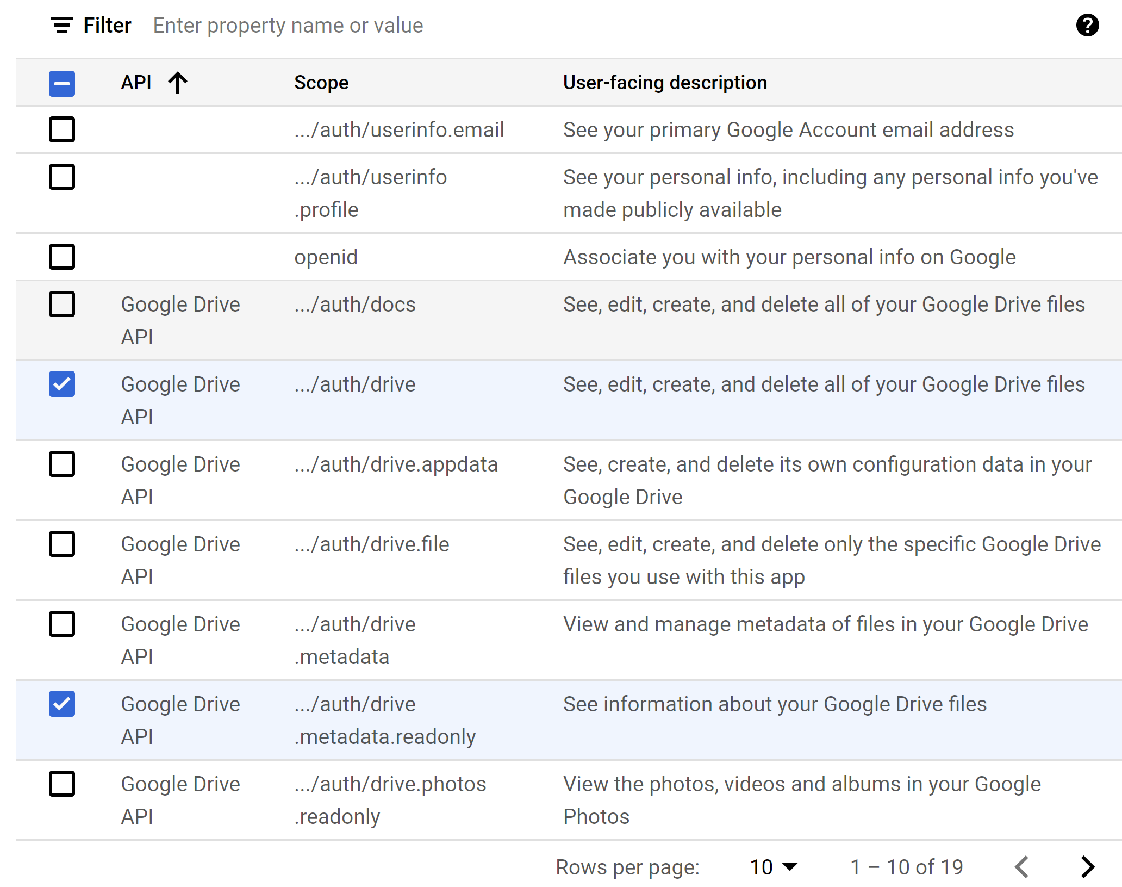
6. Select Scopes

Slide 15
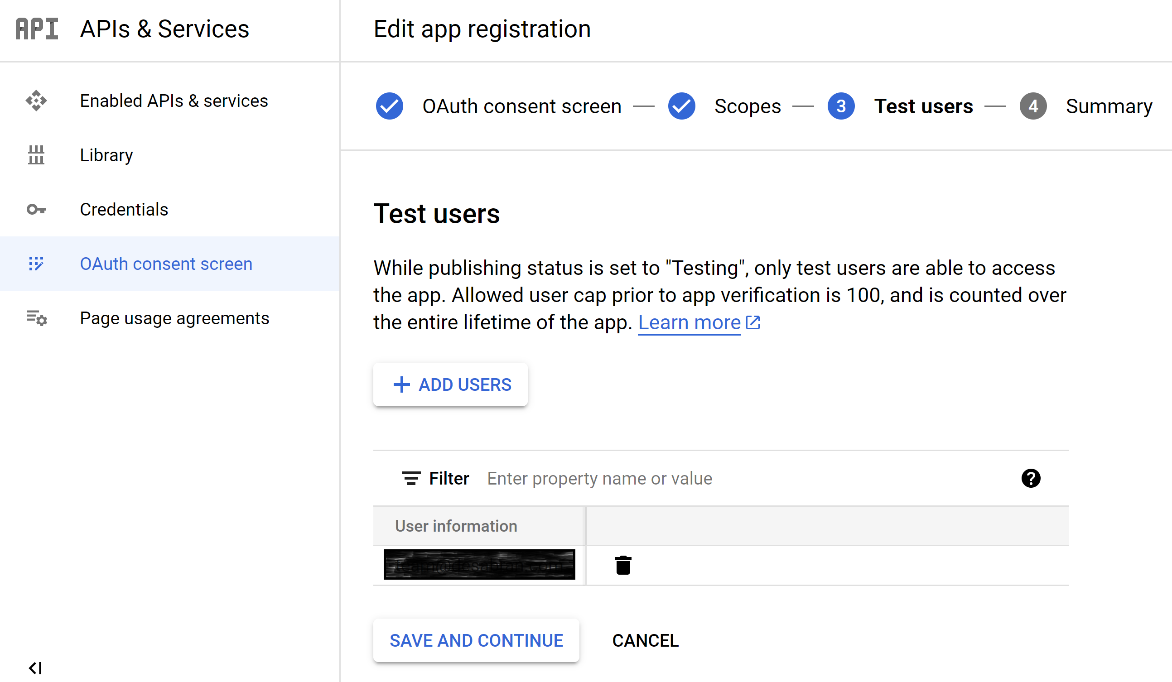
7. Add Users

Slide 16
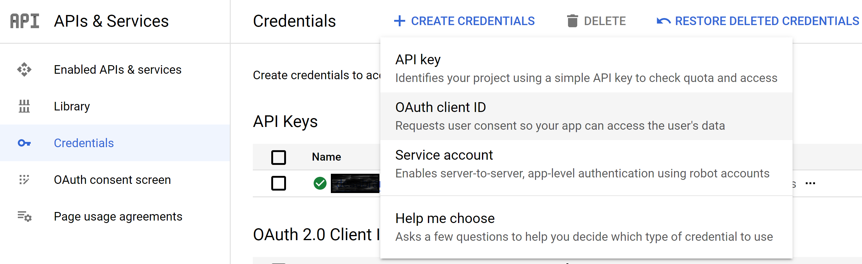
8. Create OAuth Client ID

Slide 17
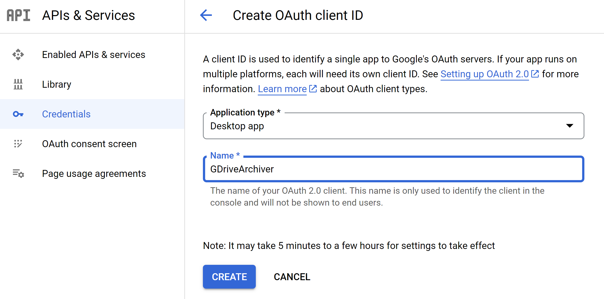
9. Select Application Type

Slide 18
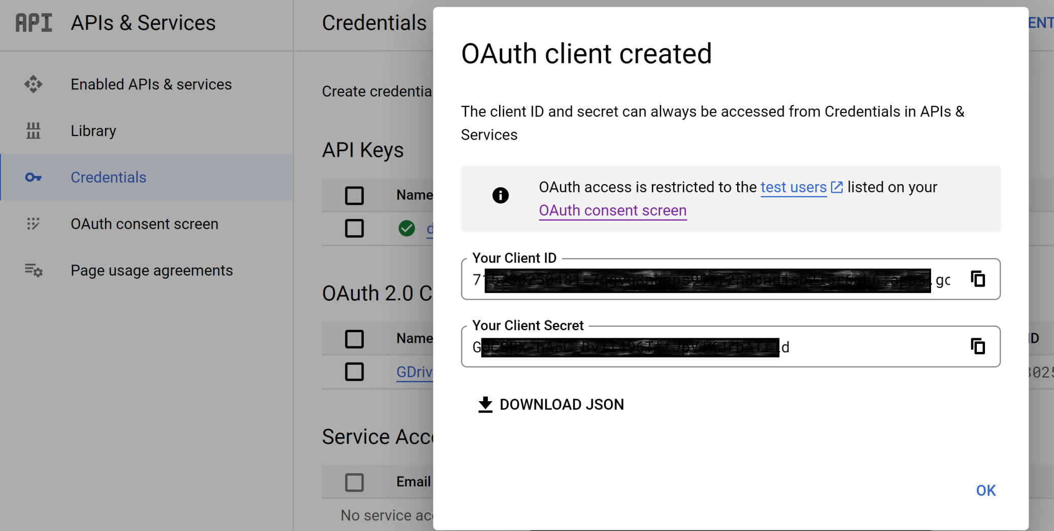
10. Download Credentials

Slide 19
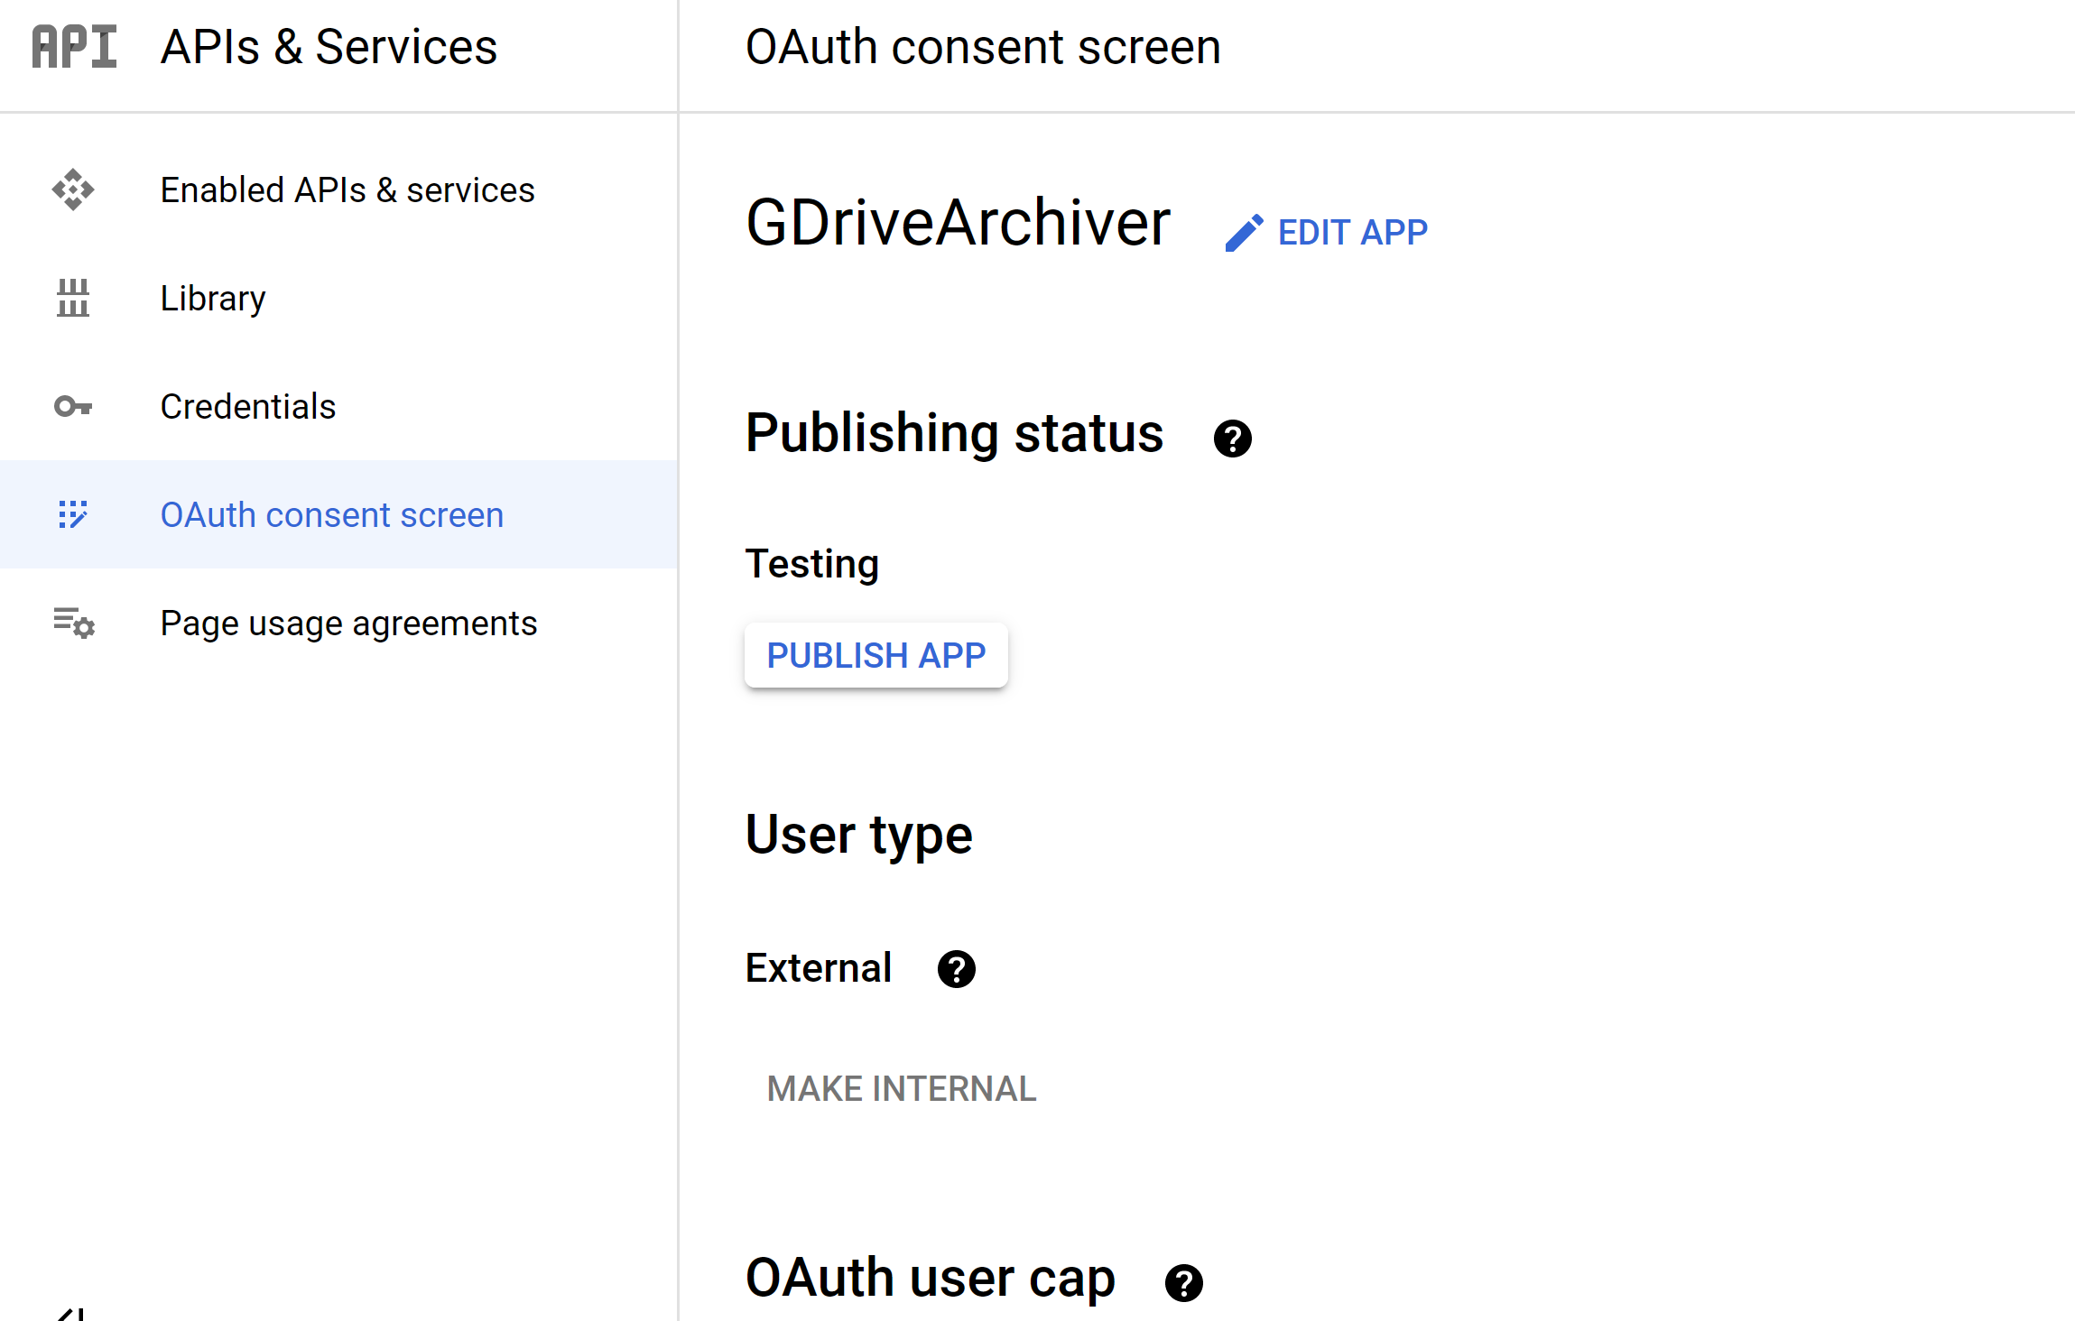
11. Publish App

Slide 20
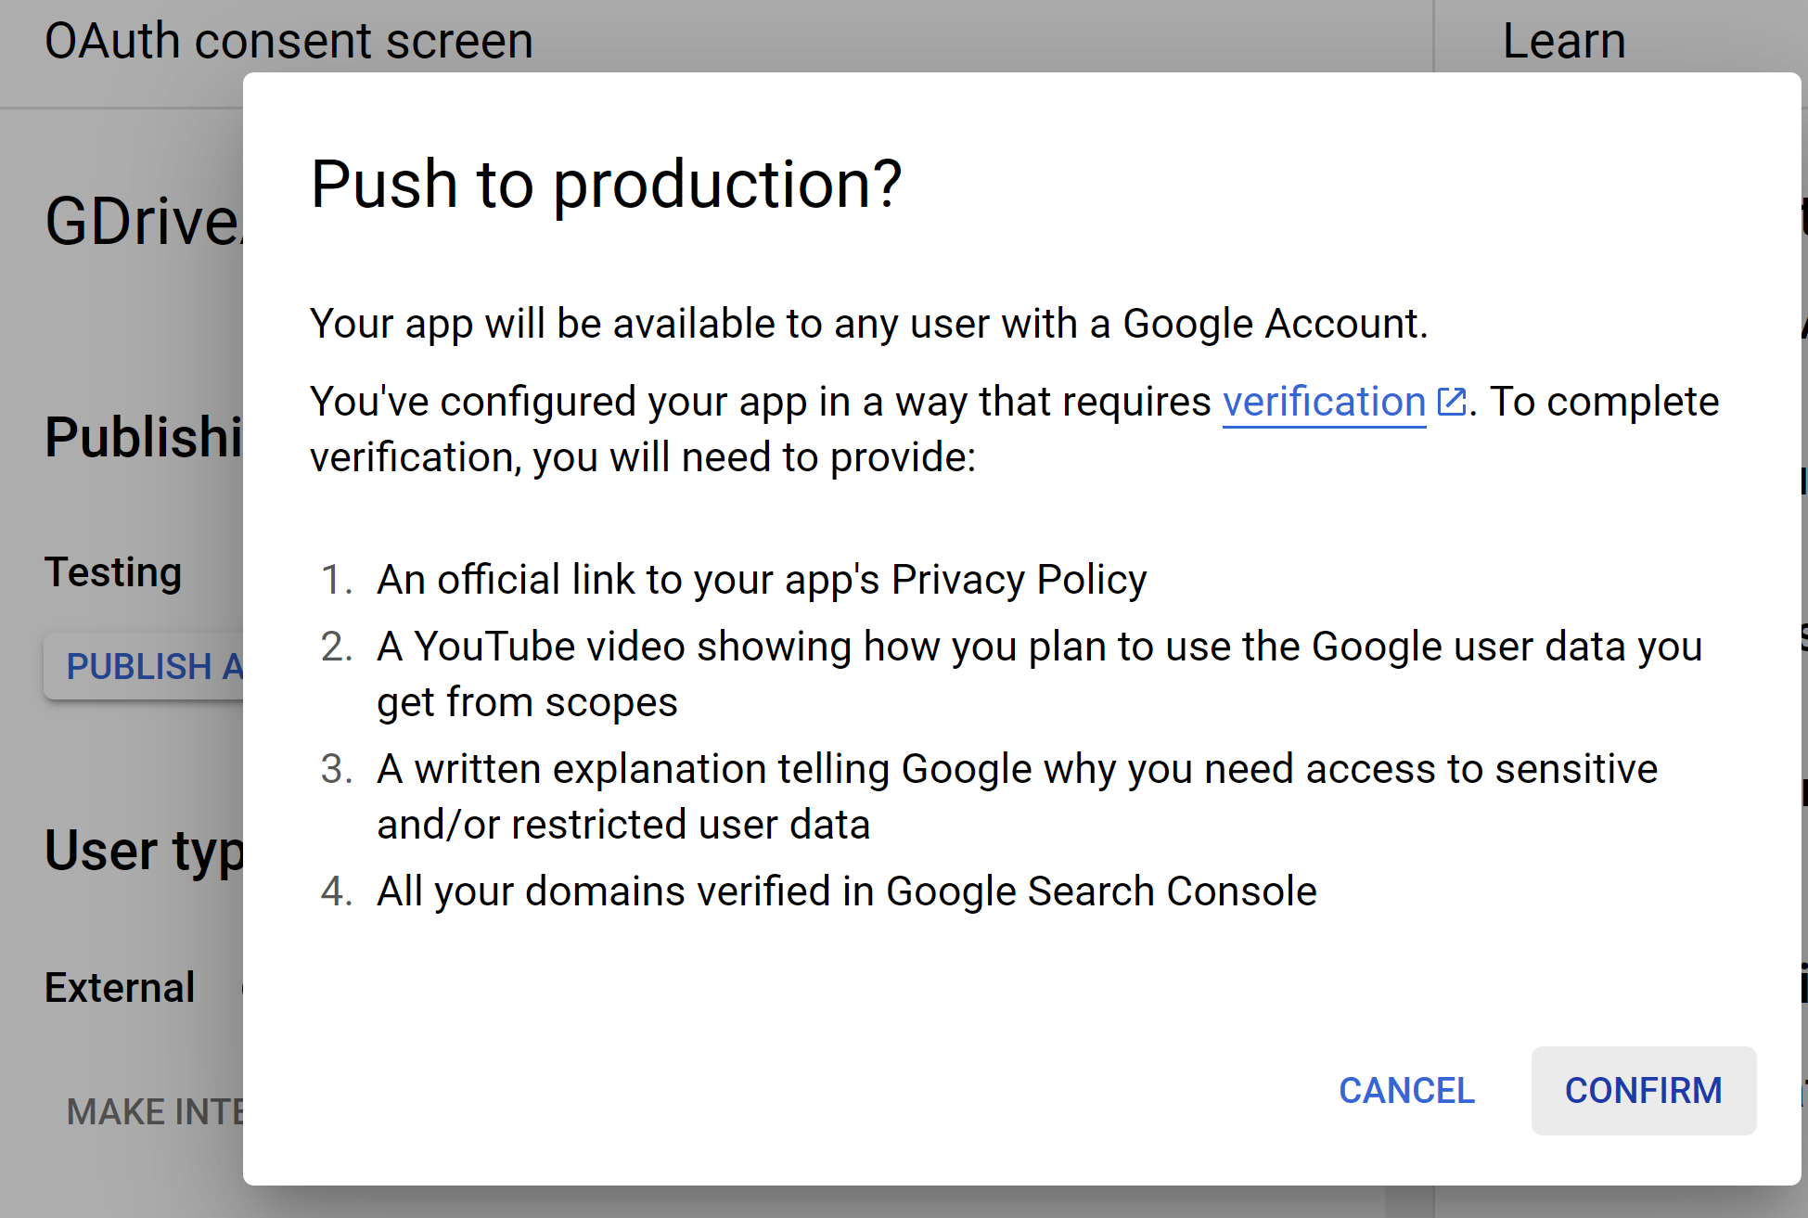
12. Confirm Publishing

Slide 22
1. Download gdrive in Ubuntu
wget https://github.com/glotlabs/gdrive/releases/download/3.9.0/gdrive_linux-x64.tar.gz
ls
tar xzvf gdrive_linux-x64.tar.gz
ls
sudo mv gdrive /usr/local/bin

Slide 23
2. Use gdrive on a Remote Server
https://github.com/glotlabs/gdrive/#using-gdrive-on-a-remote-server
gdrive account add

Slide 25
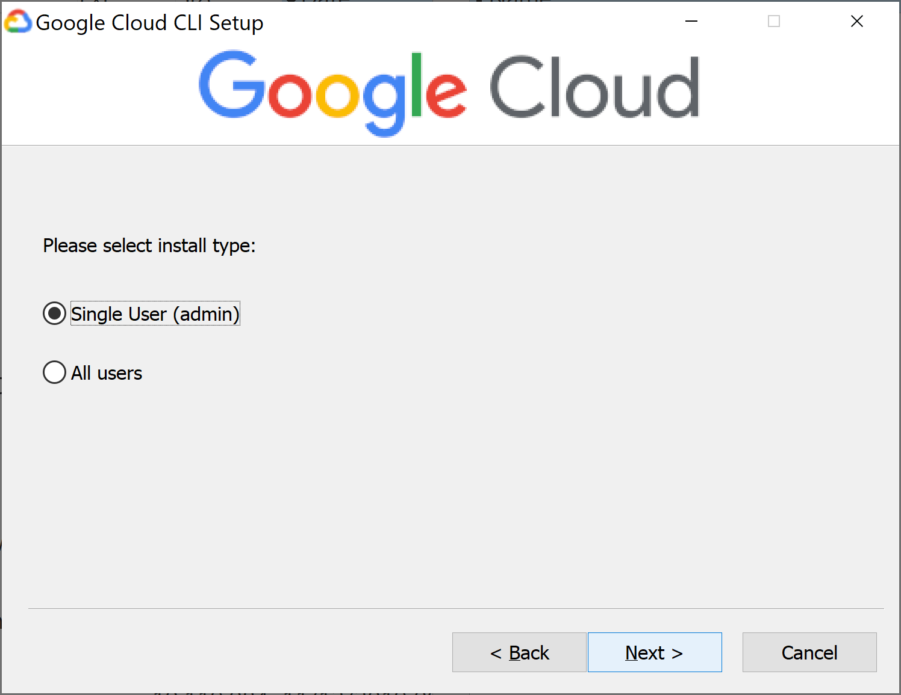
1. Install the Google Cloud CLI
https://docs.cloud.google.com/sdk/docs/install-sdk

Slide 26
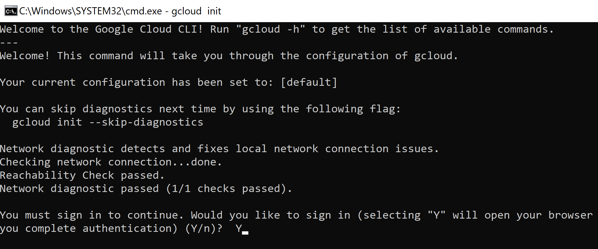
2. Log in Google Cloud
gcloud init
gcloud auth login

Slide 27

Thank You & See You Again

